Slide 1
Unconference Talk:
Performance Analysis Tool (PAT)

Slide 2
Index
What is PAT?
Problem Statement
Features of PAT Tool
Technology Used
Configuration File
Implementation
Upload Configuration File
Update Configuration File
Upload Diag Files for Analysis
Analysis View
Tree View
Report View
Steps for Validation of Each Test Case
Execution Time
Limitations for Adding more Keyword Pairs
Future Scope
Demo
NCR Coin Code

Slide 3
What is PAT?
Performance Analysis Tool (PAT) analyses the diag and produces the performance results.​
Identify the areas which are bottleneck to the performance.​
Provides detailed and easy understandable results.​

Slide 4
Problem Statement
Currently performance analysis is done manually on SCO. It takes around 4 - 5 hours for one test case​
When the test case fails, finding out the cause also takes lot of time
Solution:
PAT tool can automate this performance analysis and can also find the cause of any test case failure within seconds​

Slide 5
Features of PAT Tool
Calculate the execution time of each standard modules. (Ex: Device Enable/Disable, TBResponse etc.)
Provides Report of Analysis in two formats:
Tree Format View
User-friendly Report
Highlights all the modules exceeding the default time
Validate the test cases
Reports Wrong Diag File
Default execution Time of modules are easily configurable as per solution requirements
Test cases are easily configurable as per solution requirements.
Deployment Ready Tool

Slide 6
Technology Used
Python – Multiprocessing
Django – Web-Framework (Back-end)
jQuery – Front-end
HTML & CSS – Front-end

Slide 7
Configuration File (JSON Format)
Configuration File Fields:
Test Case Scenario – Form a pattern for each test cases to validate the uploaded Diag file. Chose correct operations to form desired test case scenarios.
Operations – By default standard operations are there. If you want, you can also add customized operations according to the requirement of test case. Example :- Transaction Start : { changing state to SMAtrract, changing state to SMScanAndBag }
Modules (Keyword Pairs) – Start and end of each modules for extracting their execution time. Customizable keyword pairs (but some limitations for tree and spreadsheet will discuss later part). Also Add Default execution time for each module if you know.

Slide 8
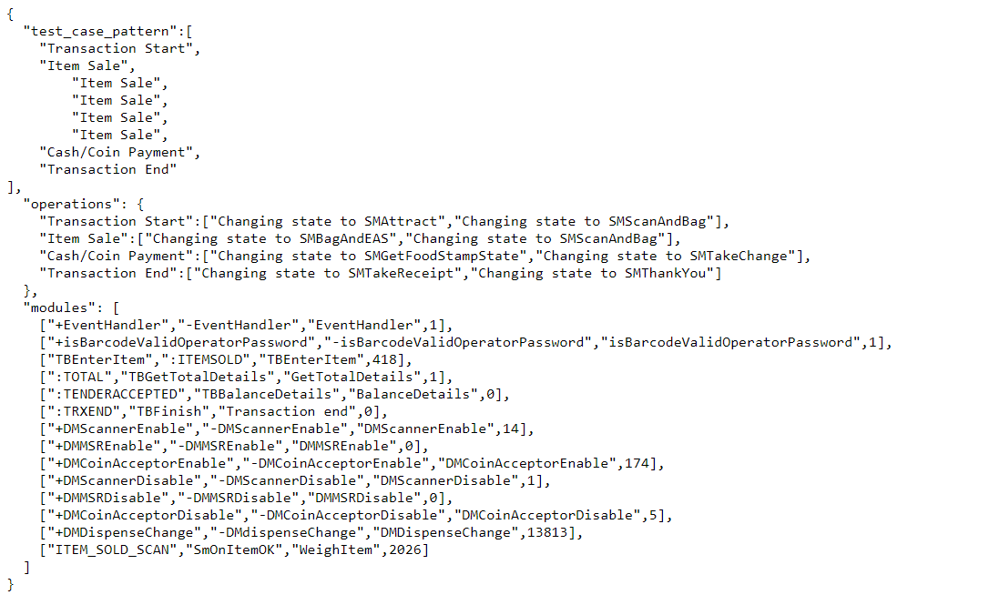
Configuration File (JSON File)
Test Case Scenario
Operations
Modules (Keyword Pair)

Slide 9
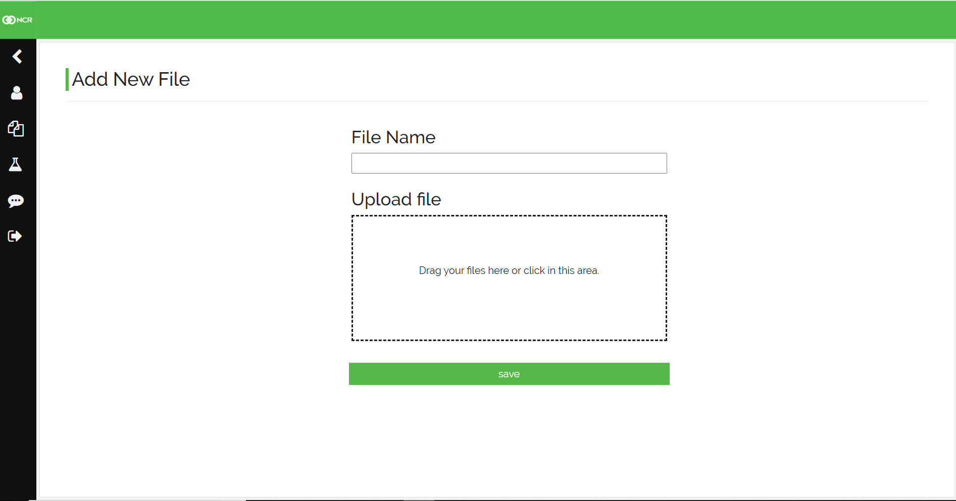
Implementations
Upload Configuration File
Fill Test Case Name Field (should be unique) then upload Json File and Click on Save Button.
Test Case Name
Upload Json File
Click on Save Button

Slide 10
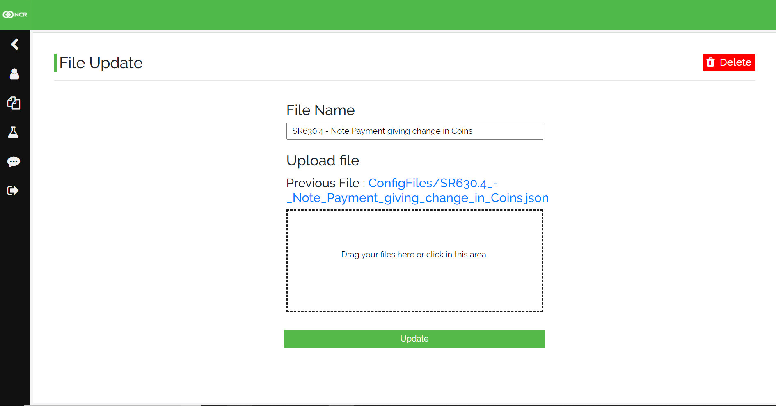
Implementations
Update Configuration File
Change Name of Test Case, Upload New Json File then press Update Button, or you can also Delete that test case.
Delete Button
Change Test Case Name
Upload Updated Json File
Click on Update Button

Slide 11
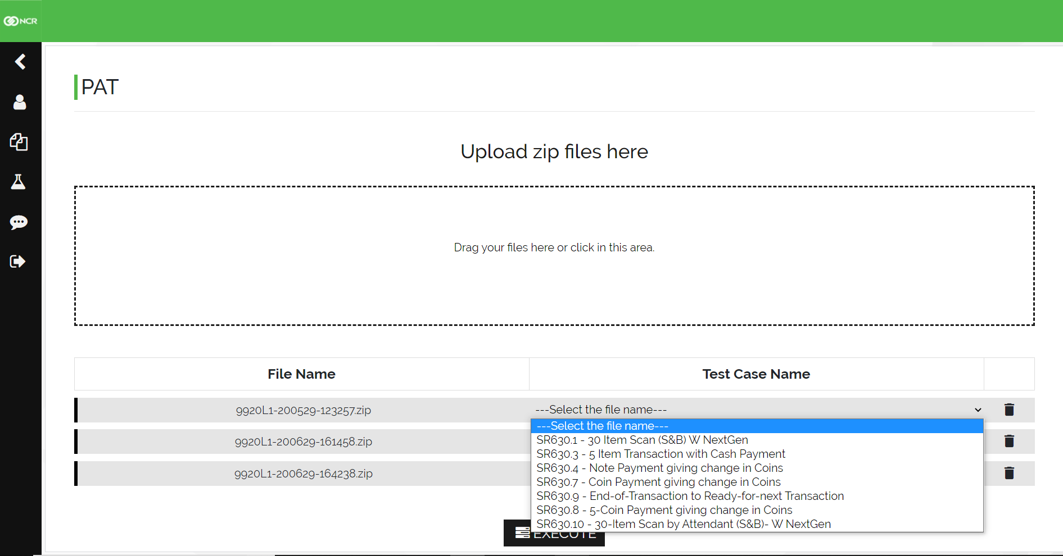
Implementations
Upload Diag Files for Analysis
Select the test case uploaded from drop-down menu for validation. After selection click on execute button.
Click on Execute button

Slide 12
Analysis View
PAT Tool provides two types of views to users i.e., Tree View and Report view (i.e., spreadsheet view)​
Tree View: Nested view. Each module contains sub-modules
Excel View: Not a Nested view. This contains all modules according to your keyword pair order​.
Both Views contains:
Line Number
Time Stamp
Whole Syntax
Module Name
Duration it took

Slide 13
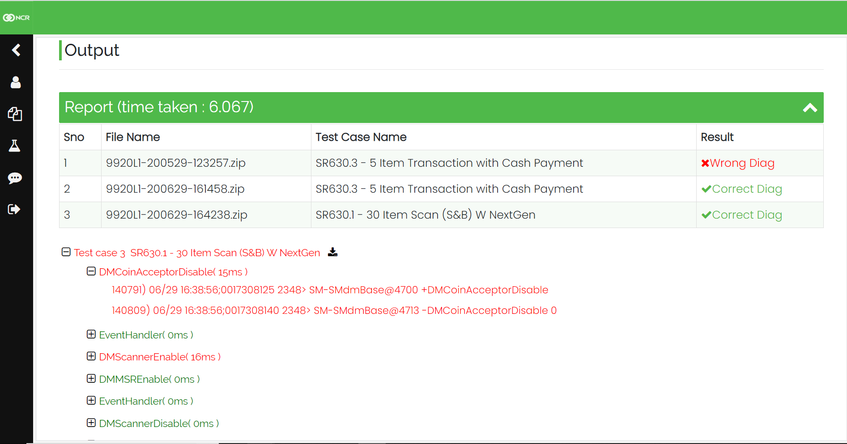
Tree View for Analysis
Report of Passed & Failed Test Cases
Extended the default execution time

Slide 14
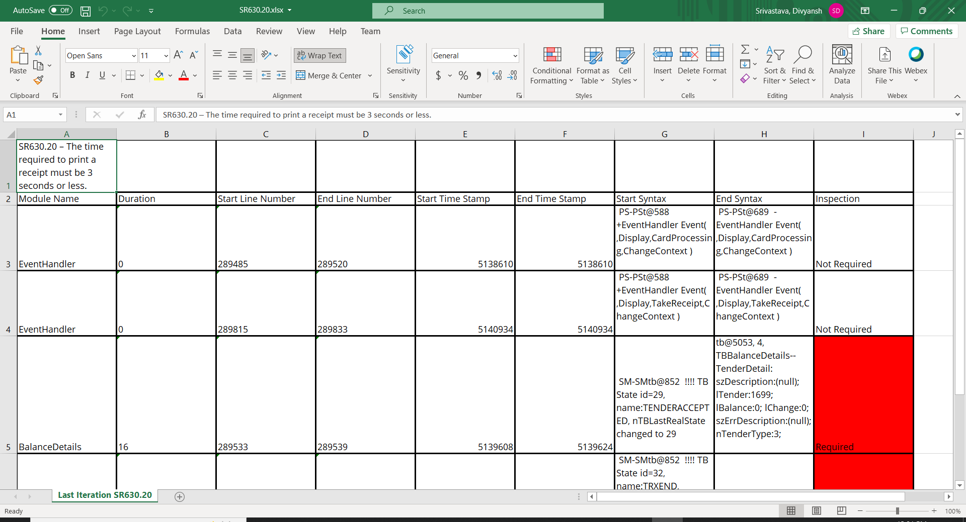
Report View for Analysis (Excel Format)

Slide 15
Steps for Validation of Each Test Case ​
For now, SCO states considered to Validate Test Cases
After operations are created, one can use them to create a test scenario
Now, we have states and correct scenario that PAT will search inside the Traces.log and Traces.log.bak​ of zip file
So, now first PAT extract the necessary details from Traces.log and Traces.log.bak and store it in a list (states) which contains​
Time Stamp​
States Name​
Index Number​
Then it will start comparing with correct test scenario and once found it will extract the starting and ending index from Traces.log and Traces.log.bak.​
Use the selected data for analysis​

Slide 16
Execution Time
30 test case – Less than 20 seconds.
1 test case – less than 3 seconds
2 test case – less than 3 seconds
Note: From above we can see the time difference between one test case executed and two got executed is same. For each test case addition, there is only an increase of 0.2 sec​
Now, how this is happening?
One line answer is Multi-processing
Since every test case starts at same time, execution time is reduced to a great extent. ​

Slide 17
Limitations for Adding more Keyword Pairs
For Tree Format View:
Keyword Pairs should be unique. (They should not be subset of any other keyword pairs)
Keywords line elements cannot be repeated in any other keywords.
One keyword’s starting should not be in between another keyword pair and end out of that keyword. (This also not favors tree format)
If there is starting point, then there should be ending point present inside the selected testcases inside Traces.log or Traces.log.bak.
For Report View (In Excel Sheet):
If there is starting point, then there should be ending point present inside the selected testcases inside Traces.log or Traces.log.bak.

Slide 18
Future Scope
With validation, Get a reason for Wrong diag
Update Configuration File without uploading a JSON file.​
Upgrade the Test Case Configuration Files.​
Configuration Files Update Track Record.​
Single click to download all performance results.​
Analyzes all the performance issues also in the Diag.

Slide 19
DEMO

Slide 20
NCR COIN CODE: GR8884

Slide 21
THANK YOU

